Slide 1



PENS
&
PRINTERS
PRODUCT
SALES
BY OTAMIRI HUMBLE

Slide 2




PROJECT OVERVIEW
Six weeks ago we launched a new line of office stationery. Despite the world becoming
increasingly digital, there is still demand for notebooks, pens and sticky notes.
Our focus has been on selling products to enable our customers to be more creative, focusedon tools for brainstorming.
Our focus has been on selling products to enable our customers to be more creative, focusedon tools for brainstorming.
Our focus has been on selling products to enable our customers to be more creative, focusedon tools for brainstorming.
We have tested three different sales strategies for this, targeted
email and phone calls, as well as combining the two.

Slide 3





PROJECT OBJECTIVES
Objective n° 1
Objective n° 2
Objective n° 3
Objective n° 1
Objective n° 2
Objective n° 3
Determine how many customers were there for each approach
Determine the overall spread
of the revenue
Determine the spread of the revenue for each sales strategy
Objective n° 4
Objective n° 5
Objective n° 4
Objective n° 5
Determine the difference in revenue over time for each of the methods
Recommend best sales strategy

Slide 4

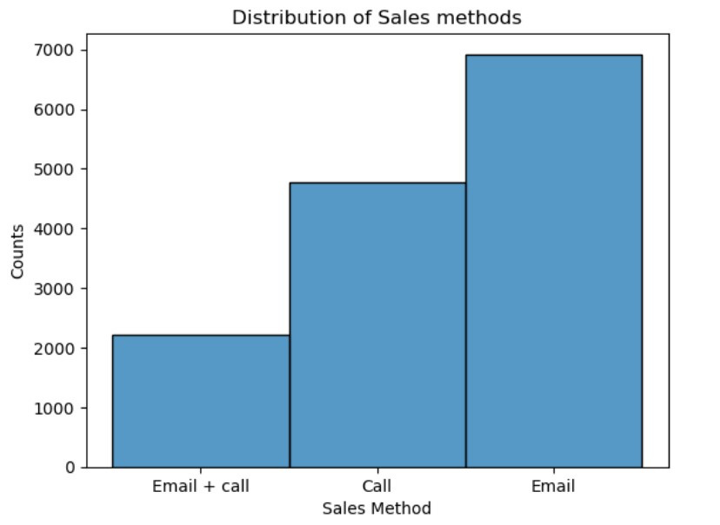
How many customers were there for each approach?
The figure shows that 'Email' sales strategy has the highest amount of customer purchases for the duration of the six(6) months and 'Email + call' sales strategy has the lowest amount of customer purchases with approximately three(3) times lesser than the amount customer purchases in 'Email' sales strategy. The 'Call' sales strategy has approximatly double the amount of customer purchases in the 'Email and call' sales strategy

Slide 5
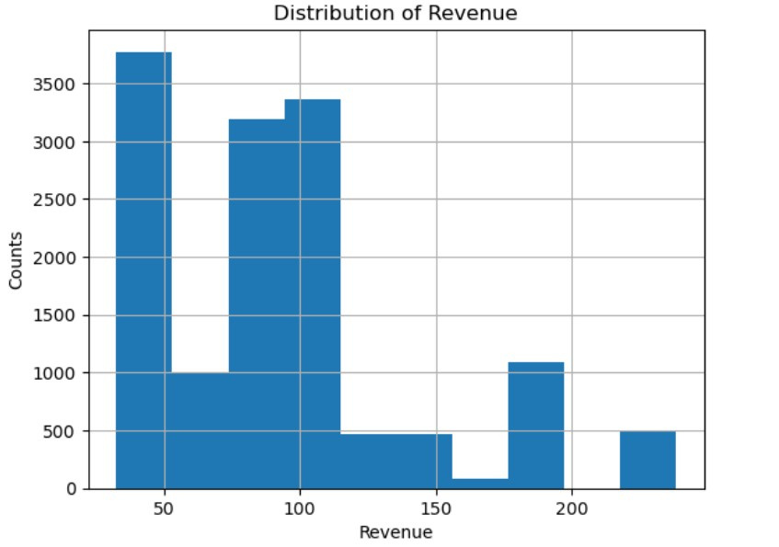
What does the spread of the revenue look like overall?
Overall, the majority of the revenue is under 150 for the six(6) months duration. The chart shows a left skewed revenue distribution

Slide 6
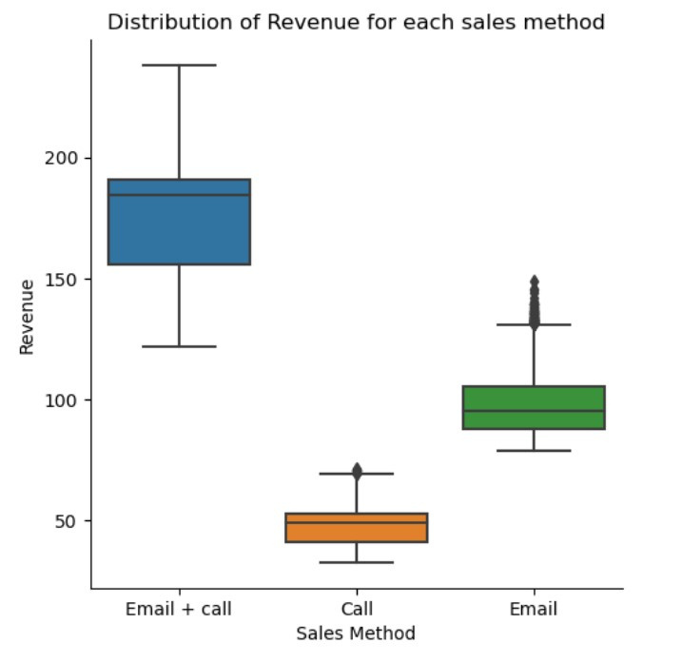
What does the spread of the revenue look like for each method?
From the box plot, it will be observed that 'Call' sales strategy has the bulk of its revenue around 50 and slightly below and 'Email' strategy has the bulk of its revenue around 100 and slightly below accounting for highest revenue distribution while 'Email and Call' has the bulk of its revenue above 150 which has the least revenue distribution

Slide 7
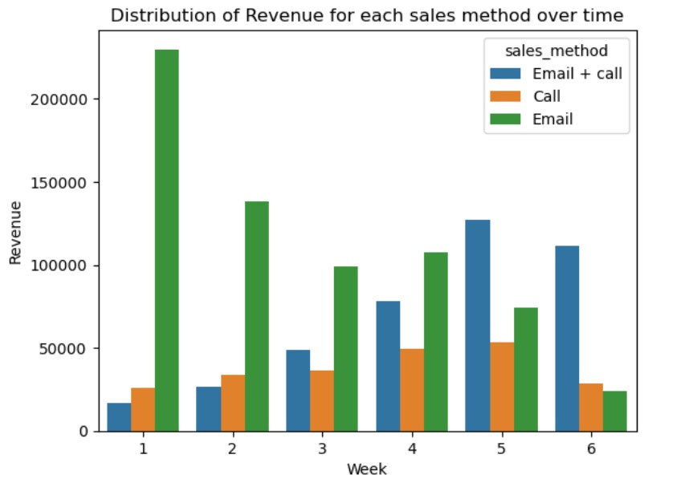
Was there any difference in revenue over time for each of the methods?
It will be observed from the above bar chart that the relationship of revenue distribution for each sales method over time is inversely correlated. As 'Email' sales strategy is highest at week 1 and steadily declines over the weeks ahead while 'Email + call' sales strategy is lowest at week 1 and steadily increases over the following weeks.

Slide 8
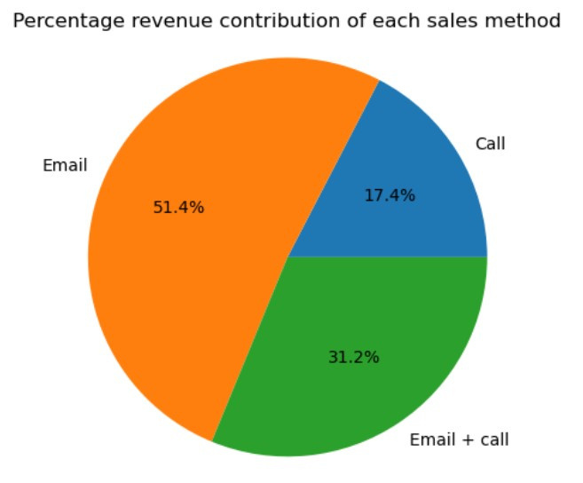
Business Metrics
To achieve our goal, I will recommend the use of percentage revenue contribution of each sales method as our metric.
The pie chart below shows the percentages of revenue for the data in consideration. 'Email' sales strategy accounts for slightly above half (51.4%) of the revenue contribution while 'Email and call' and 'Call' sales strategy accounts for the rest with 31.2% and 17.4% respectively

Slide 9
Recommendations
Use the recommended business metrics to monitor each sales method contribution to the revenue in the coming weeks.
Observe the trend in the total revenue for each sales method over time, noting the strategy that is increasing or decreasing with time.
I will recommend the continuation of 'Email' and 'Email + call' strategy since they are the highest revenue contributors and requires lesser time compared to 'Call' strategy which contributes the least revenue.
I recommend that more resources should be allocated to the 'Email + call' strategy since it shows the best potential to steadily increase the revenue over time
The data collection process should be improved to eliminate missing values and improper data entries

Slide 10

THANK'S FOR WATCHING
PENS
&
PRINTERS

